Slide 1
Week 4
Meshing Experiments on Impeller

Slide 2
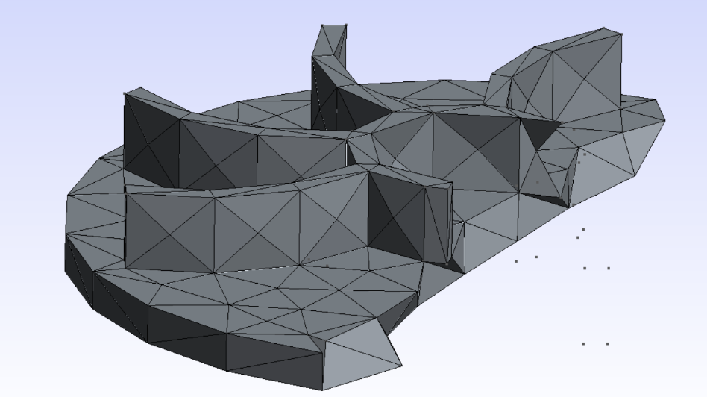
Full Auto 3D mesh
Geometric Decay: The high-curvature leading edges of the blades were represented by only 2 or 3 elements, turning a smooth aerodynamic surface into a jagged, "stair-stepped" profile.
Volume Inefficiency: The fluid gaps between blades were filled with massive, low-quality tetrahedral mesh.

Slide 3
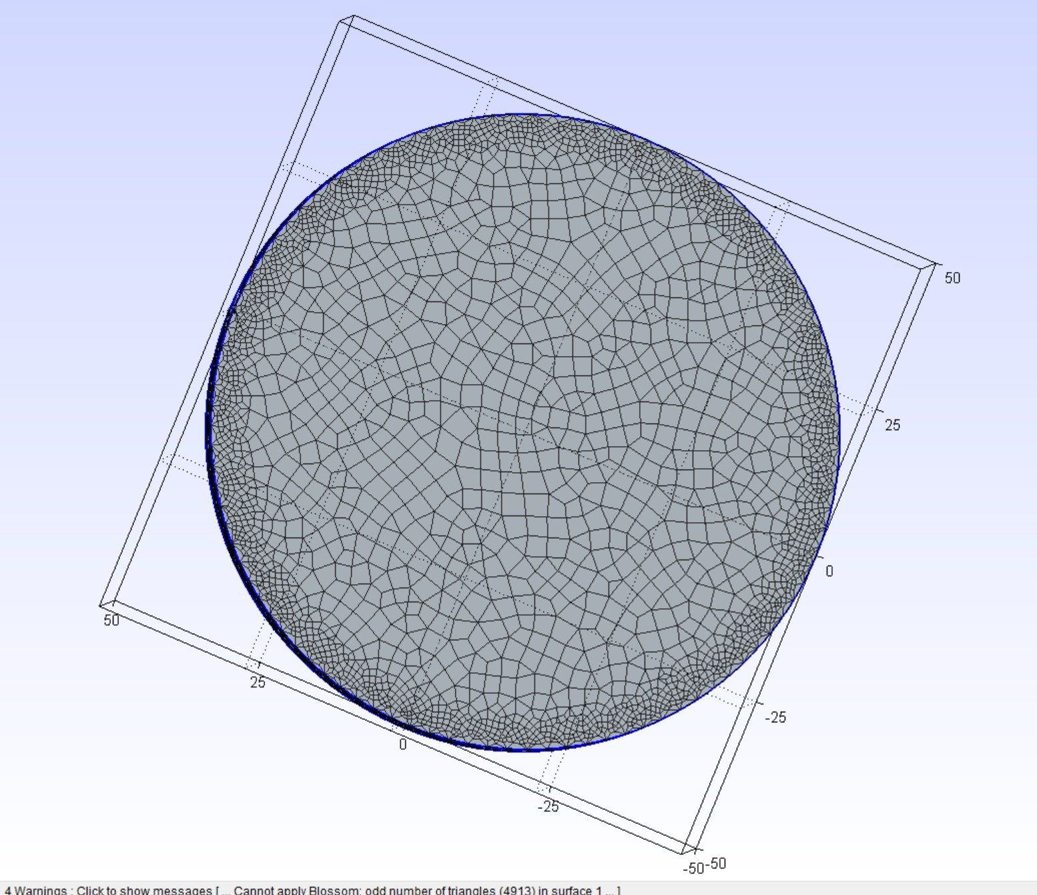
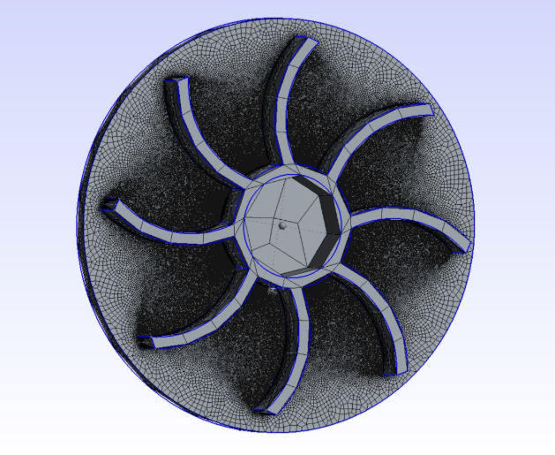
Global Transfinite Mesh

Slide 4
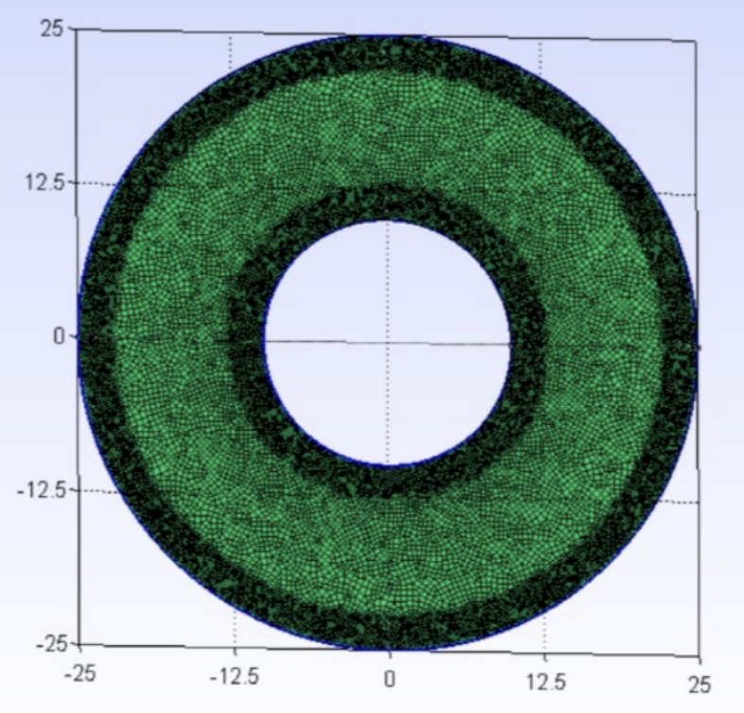
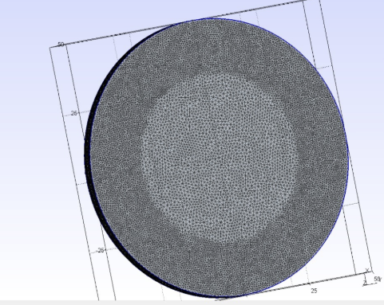
Field based refinement
We achieved a "halo" of refinement. The mesh was only fine where it mattered (the boundary layer region), and it transitioned smoothly to a coarse, computationally cheap mesh in the open fluid passages.

Slide 5
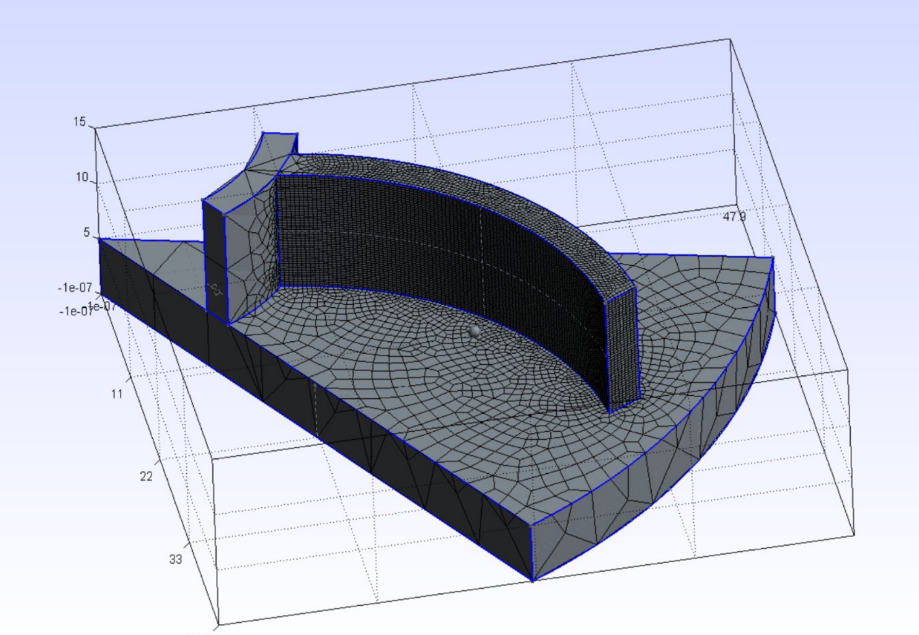
1/8th Geometry Partitioning
This experiment revealed significant geometry symmetry issues. * The "Non-Conformal" Problem: For a solver to treat a 1/8th slice as periodic, the nodes on the "left" cut-face must be in the exact same spatial locations as the nodes on the "right" cut-face when rotated.
Unstructured Conflict: Because we used unstructured 3D meshing, the nodes were placed randomly within the field constraints. Consequently, the two side faces did not match.
Conclusion: Slicing a STEP file is not enough; without specific "Periodic" constraints, a partial mesh is useless for a rotating simulation.

Slide 6
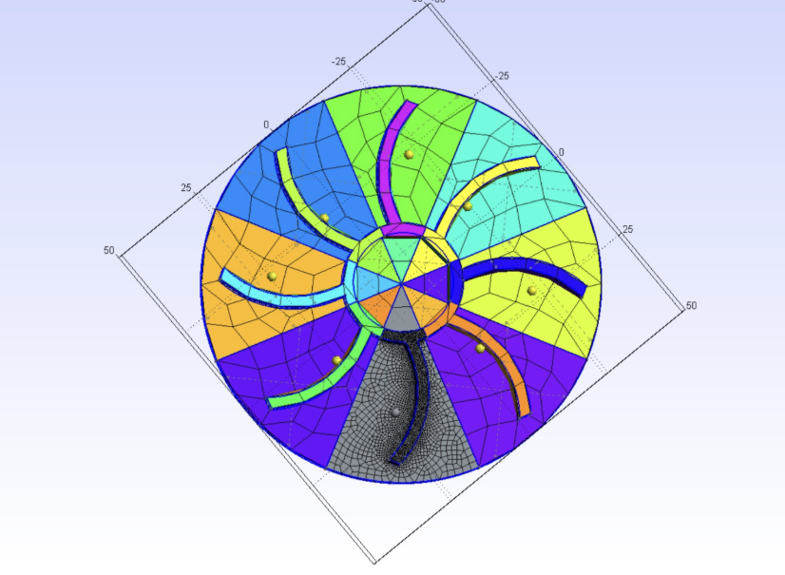
1/8th Sector & Transformation Limits
We discovered a hard architectural limit in Gmsh: The software does not allow the transformation of mesh data.
The Result: The script successfully created 7 new geometric volumes in a circle. However, these volumes were empty. When we ran the Mesh 3 command, Gmsh re-meshed each volume individually from scratch.

Slide 7
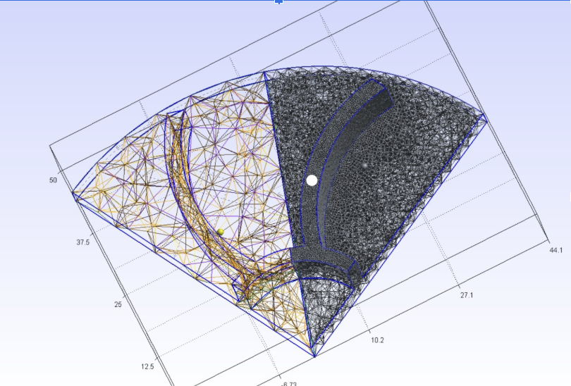
Periodic Mesh Linking
Following Tutorial T18, we implemented the Periodic Surface command. Told Gmsh: "Do not mesh Face B; instead, take the mesh from Face A, rotate it 45 degrees, and paste it onto Face B."

Slide 8
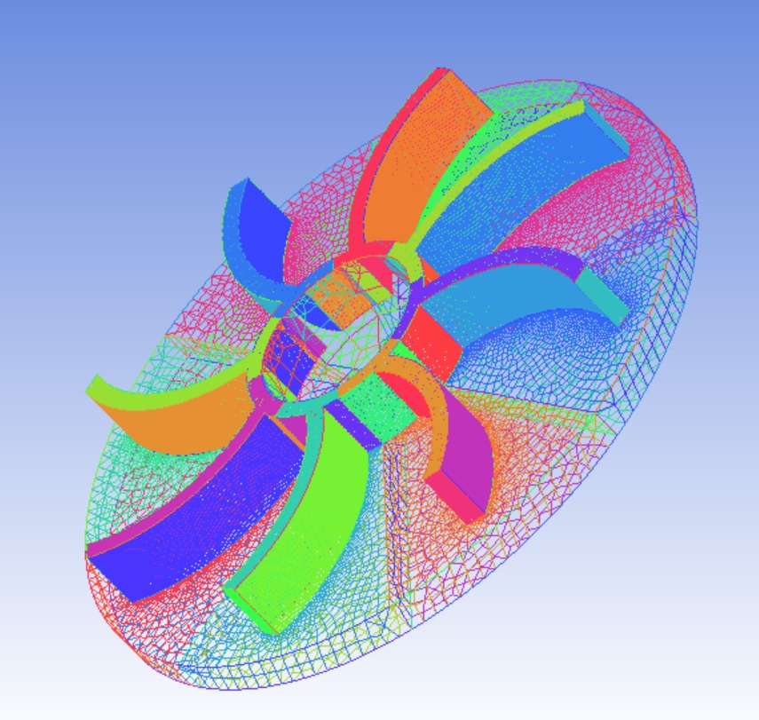
Cross-Platform Analysis (Ansys ICEM CFD)
We imported our 1/8th STEP-based mesh into Ansys ICEM CFD. ICEM is a "bottom-up" mesher that allows for the direct manipulation of nodes and elements.
We used the Transform Mesh tool to rotate and copy the 1/8th mesh seven times.

